Slide 1

SYNERGY Conference on violence against women and girls in times of war and displacement
30 March 2022

Slide 2
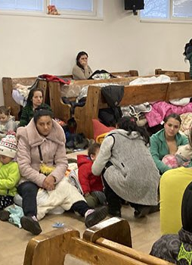
Antigypsyism
Multiple-discrimination
In normal times, antigypsyism and prejudices are widespread
In times of war, when solidarity should be colour-blind, these deep-rooted prejudices remain.
Multiple-discrimination:
  Gender
  Roma
  Language barrier
  Lack of understanding of administrative procedures
  Lack of identification documents or statelessness

Slide 3
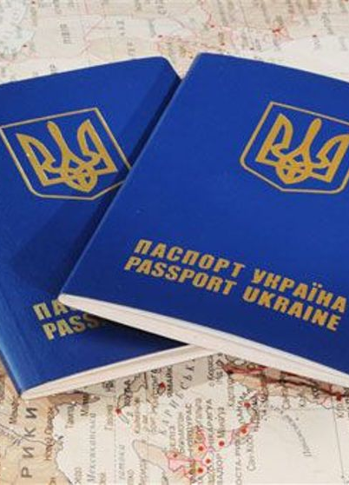
Lack of ID
Statelessness
Over 82 000 stateless or undocumented people in Ukraine according to 2001 census.
In 2021, the UNHCR estimated there to be 35,875 stateless and people with ‘undetermined nationality’.
It is estimated that 10 to 20% of Roma are undocumented and that there are up to 400 000 Roma in Ukraine. In theory this means that up to 80 000 Roma could be stateless or undocumented.

Slide 4
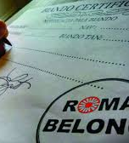
Lack of ID
Statelessness
NGOs and associations working in Ukraine and in the receiving countries report that stateless and undocumented people fleeing the crisis face additional barriers when seeking safety and Roma are disproportionately affected.
Lack of ID papers or nationality increases the vulnerability of Roma women and children, firstly because they may not be able to leave Ukraine but also because they are at higher risk of human trafficking and exploitation.

Slide 5
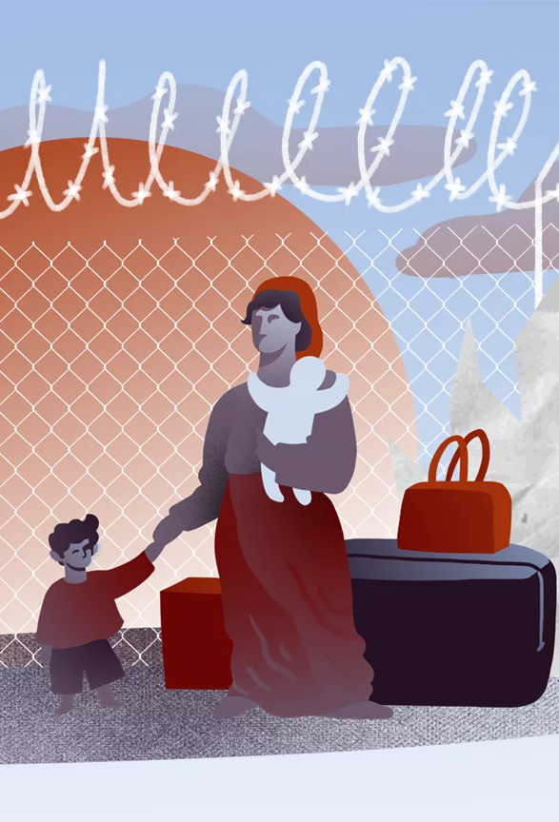
Lack of ID
Statelessness
At the border crossing in the southwestern region of Zakarpattiya, people without identification are not being allowed to leave the country. That region has the biggest concentration of Roma people in Ukraine
Ukrainian Roma fleeing the Russian aggression to neighbouring Moldova are turned back because of a lack of personal identification

Slide 6
Lack of ID / Statelessness
EU decided on 4 March to activate the Temporary Protection Mechanism which makes it possible for authorities supervising border crossings to ease their controls, including when people do not have identification, and urges the Member States to issue declarations of arrival and/or temporary travel documents for undocumented. However, EU Member States are not currently required under EU law to extend temporary protection to most stateless people and those at risk of statelessness who are/were living in Ukraine.

Slide 7

Roma mobilisation
Roma NGOs have mobilised in Poland, Slovakia, Romania, Moldova and Hungary and are coordinating their efforts to receive, assist and support Ukrainian Roma refugees together with the other NGOs, associations, national authorities, volunteers, border guards and law enforcement agencies.

Slide 8
Recommendations
European States should ensure that lack of identity documents or other documentation does not prevent stateless people and people at risk of statelessness from accessing international protection or other forms of protection under national
Register undocumented or stateless people to ensure their access to adequate protection and assistance.
Sensitise volunteers and staff at reception centres to the specific needs of Ukrainian minorities and Roma.

Slide 9
THANK YOU!
Valerie Poppe
Roma and Travellers Team
Contact: valerie.poppe@coe.int

