Slide 1

SYNERGY Conference
Protecting Refugee, Migrant and Asylum-seeking Women and Girls
30 March 2022
Cécile Gréboval, Programme Manager – Gender mainstreaming, Gender Equality Advisor

Slide 2
Council of Europe intergovernmental work
on migrant women
  Recommendation of 1979 on women migrants
  Gender Equality Strategy 2018-2023: new focus on ‘Protect the rights of migrant, refugee and asylum-seeking women and girls’
  Drafting of new Committee of Ministers recommendation on protecting the migrant women (2020-2021)
  To be adopted by the Committee of the Ministers in 2022
Notes:
1979 recommendation focusing on work, socio-economic integration, training – no mention of asylum or issues of VAW, women on the move or trafficking

Slide 3
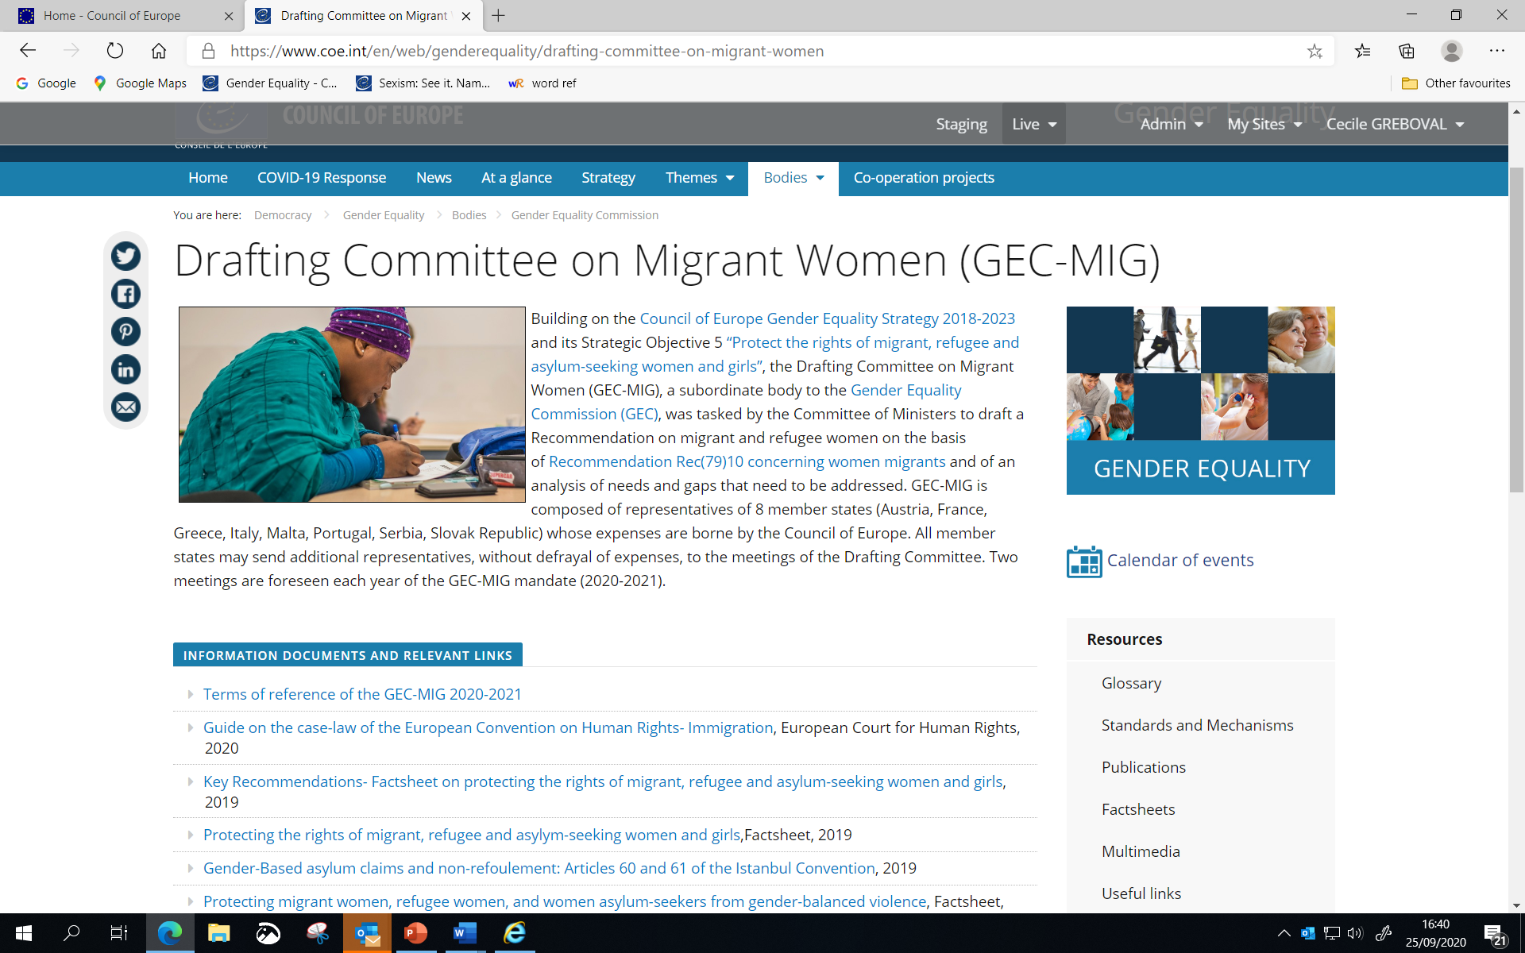

Slide 4
Objectives of draft Recommendation
Gathering in one document “best” measures in existing CoE standards, monitoring activities, UN policy documents, etc.
Focus on the protection of rights and the fight against all forms of violence against women
Focus on the specific concrete needs of women and girls
Looking at the range of relevant public policies: migration, asylum and integration policies
Including ALL migrant, refugee and asylum-seeking women and girls
Intersectional perspective / addressing the needs of specific groups: girls, women with disabilities, undocumented migrant women, victims of violence, etc.

Slide 5
Content of draft Recommendation (1)
Transversal issues:
Looking at the needs of girls in terms of protection, reception systems, unaccompanied girls
The need to give accessible access to all types of relevant information for migrant women
The need to facilitate access to justice including access to legal aid, availability of interpreters, legal professional – preferably women
Cooperation and support to civil society that defend & support migrant women
Notes:
Information about rights, about access to justice, existing services

Slide 6
Content of draft Recommendation (2)
Protection & support
Protecting victims of gender-based violence and trafficking, in particular trafficking for the purpose of sexual exploitation
Training of relevant authorities and staff in gender equality issues and violence
Access to support services and to shelters + type of support & services needed

Slide 7
Content of draft Recommendation (3)
Arrival:
Transit and reception facilities: concrete recommendations in terms of infrastructures (safety, hygiene facilities, separate sleeping areas…)
Addressing the special needs of women with disability, older, pregnant women, victims of violence
Training of staff & presence of women among staff
Need for asylum policies and procedures that take into account women’s experience of persecution
Ensure the possibility for women to lodge an independent asylum claim from their spouse or parents

Slide 8
Content of draft Recommendation (4)
Residence and integration
Access to health services, including sexual and reproductive health & rights
Social services, social security and housing
Integration, empowerment, social and political participation
Education & training
Employment rights
Residence permits & family reunion

Slide 9
Content of draft Recommendation (5)
Detention
Administrative detention in the context of migration as last resort
Age- and gender sensitive approach to all aspects of deprivation of liberty (infrastructure, assistance, presence of women among staff etc)
Returns
In safety and dignity – ex assessment of country of origin information
Non-refoulement from a gender sensitive perspective

Slide 10

Cecile.greboval@coe.int
www.coe.int/equality

